Slide 1
Homeostasis
Osmoregulation– Nitrogenous waste

Slide 2
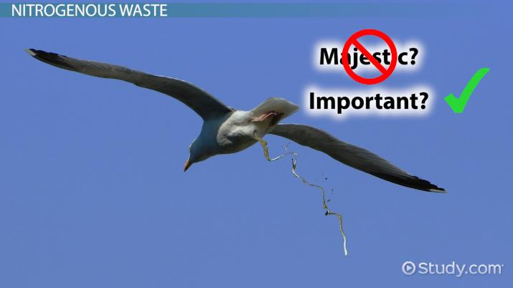
Nitrogenous waste
Nitrogenous wastes are metabolic waste products that contain nitrogen; the result of the metabolic breakdown of proteins and nucleic acids.
Excretion is the removal of nitrogenous wastes.
Notes:
When animals breakdown amino and nucleic acids, nitrogenous waste is formed in the form of ammonia.

Slide 3
Nitrogenous waste
One such nitrogenous waste is ammonia, which is extremely toxic. A build-up of ammonia in cells can affect their pH severely.
Ammonia makes cell contents more basic, which can denature enzymes and compromise their function. This, in turn, can reduce metabolic activity.
Notes:
Ammonia is highly basic, toxic and can be very reactive. Marine and freshwater organisms can release the ammonia directly into the surrounding water.
Terrestrial organisms convert ammonia into a less toxic form (urea or uric acid) before excretion. What form depends on the animal's evolutionary history and habitat.
Amphibians release waste as ammonia as larvae and urea as adults
Birds and insects release ammonia as uric acid.
Uric acid does not require water and is highly concentrated. This is beneficial to these organisms as they do not have to carry the extra water around (less energy for flight)
Mammals release their waste in the less toxic form known as urea

Slide 4
Metabolic waste
Major waste product – nitrogenous waste
Created from the breakdown of proteins & nucleic acids
  When used for energy
  When converted to carbohydrates & fats
Waste converted to
  Ammonia
  Urea
  Uric acid

Slide 5
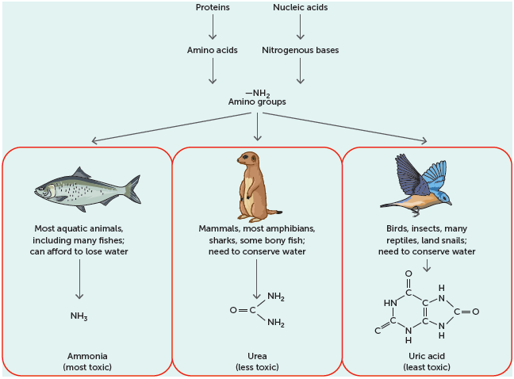
Nitrogenous waste

Slide 6
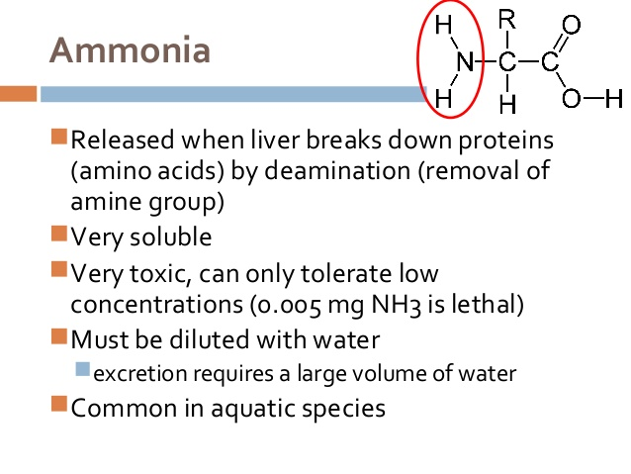
Nitrogenous waste

Slide 7
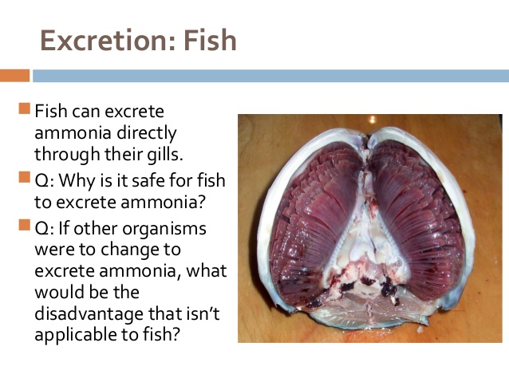
Nitrogenous waste

Slide 8
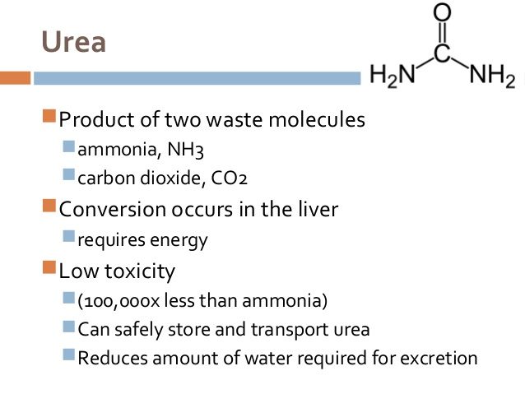
Nitrogenous waste

Slide 9
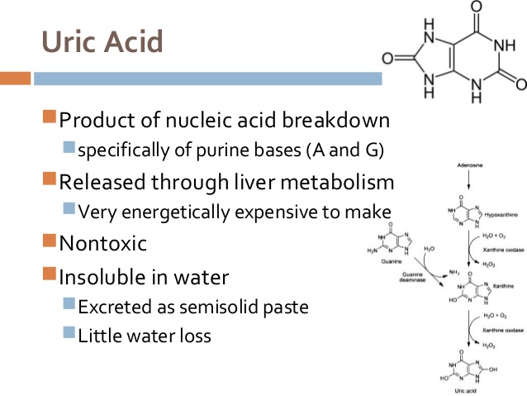
Nitrogenous waste

Slide 10
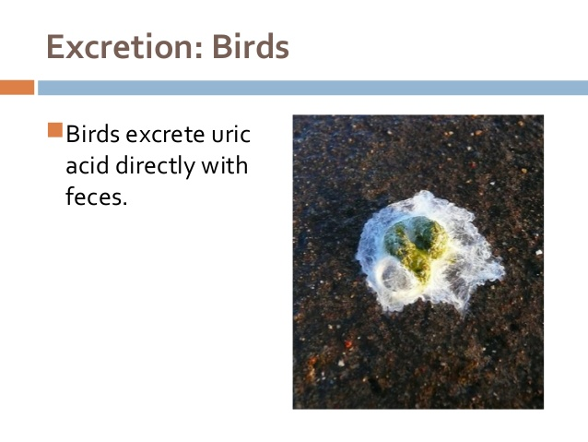
Nitrogenous waste

Slide 11
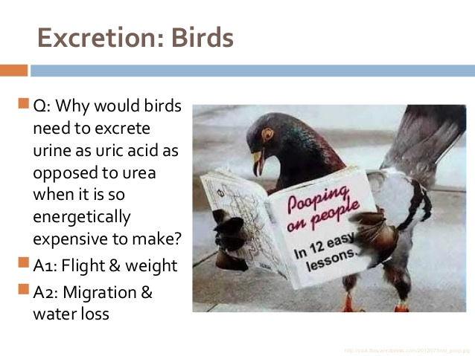
Nitrogenous waste

Slide 12
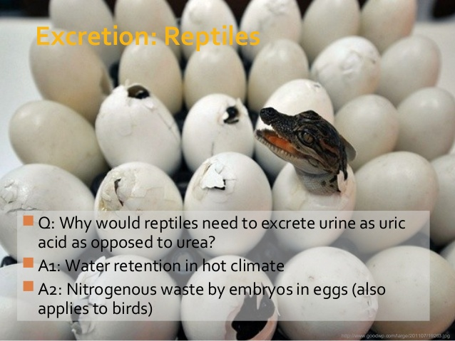
Nitrogenous waste

Slide 13
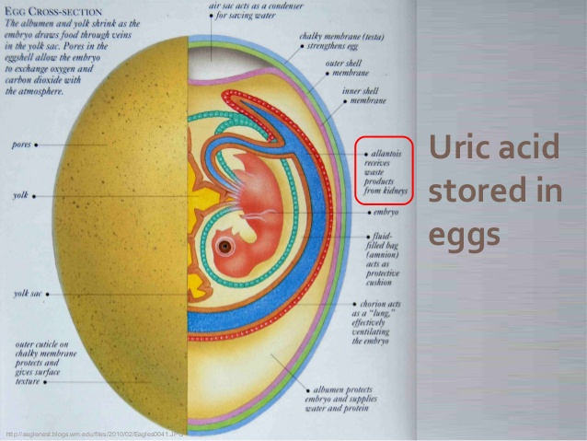
Nitrogenous waste

Slide 14
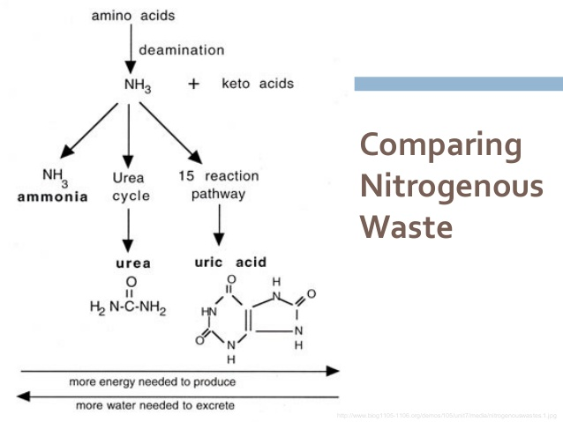
Nitrogenous waste

Slide 15
Exam focus
What are the recuring themes of the exam questions?
Name the nitrogenous waste produced by different vertebrate groups
Relate toxicity, solubility and energy to each nitrogenous waste
Relate water availability of the environment to the type of nitrogenous waste produced by the vertebrate
Vertebrate evolution & nitrogenous waste

Slide 16
Activities
Complete Nitrogenous Waste Table
Biology WA Units 3 & 4
  Set 11.2 pg 377 Q 1 – 4

